Slide 1
5
Elasticity and Its Applications

Slide 2

Figure 1 The Price Elasticity of Demand
(a) Perfectly Inelastic Demand: Elasticity Equals 0
Price
Demand
€ 5
4
1. An
increase
in price . . .
0
100
Quantity
2. . . . leaves the quantity demanded unchanged.
Copyright©2003 Southwestern/Thomson Learning

Slide 3
Figure 1 The Price Elasticity of Demand
(b) Inelastic Demand: Elasticity Is Less Than 1
Price
€ 5
4
1. A 22%
Demand
increase
in price . . .
0
90
100
Quantity
2. . . . leads to an 11% decrease in quantity demanded.

Slide 4
Figure 1 The Price Elasticity of Demand
(c) Unit Elastic Demand: Elasticity Equals 1
Price
€ 5
4
1. A 22%
Demand
increase
in price . . .
0
80
100
Quantity
2. . . . leads to a 22% decrease in quantity demanded.
Copyright©2003 Southwestern/Thomson Learning

Slide 5
Figure 1 The Price Elasticity of Demand
(d) Elastic Demand: Elasticity Is Greater Than 1
Price
€ 5
4
Demand
1. A 22%
increase
in price . . .
0
50
100
Quantity
2. . . . leads to a 67% decrease in quantity demanded.

Slide 6
Figure 1 The Price Elasticity of Demand
(e) Perfectly Elastic Demand: Elasticity Equals Infinity
Price
1. At any price
above €4, quantity
demanded is zero.
€ 4
Demand
2. At exactly €4,
consumers will
buy any quantity.
0
Quantity
3. At a price below €4,
quantity demanded is infinite.

Slide 7
Figure 2 Total Revenue
Price
€4
P × Q = €400
P
(revenue)
Demand
0
100
Quantity
Q
Copyright©2003 Southwestern/Thomson Learning

Slide 8
Figure 3 How Total Revenue Changes When Price Changes: Inelastic Demand
Price
Price
An Increase in price from €1
to €3 …
… leads to an Increase in total revenue from €100 to €240
€3
Revenue = €240
€1
Revenue = €100
Demand
Demand
0
100
Quantity
0
80
Quantity
Copyright©2003 Southwestern/Thomson Learning

Slide 9
Figure 4 How Total Revenue Changes When Price Changes: Elastic Demand
Price
Price
An Increase in price from €4
to €5 …
… leads to an decrease in total revenue from €200 to €100
€5
€4
Demand
Demand
Revenue = €200
Revenue = €100
0
50
Quantity
0
20
Quantity
Copyright©2003 Southwestern/Thomson Learning

Slide 10
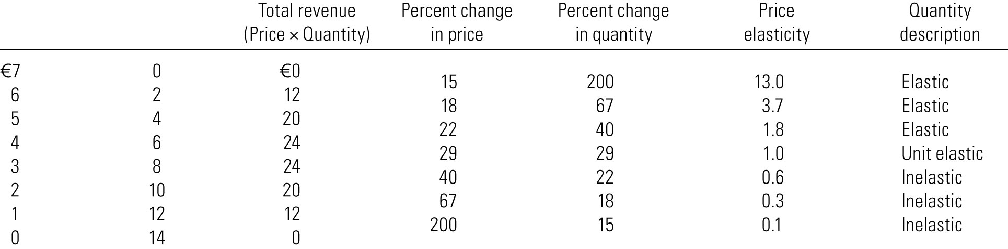
Elasticity of a Linear Demand Curve

Slide 11
Figure 6 The Price Elasticity of Supply
(a) Perfectly Inelastic Supply: Elasticity Equals 0
Price
Supply
€5
4
1. An
increase
in price . . .
0
100
Quantity
2. . . . leaves the quantity supplied unchanged.
Copyright©2003 Southwestern/Thomson Learning

Slide 12
Figure 6 The Price Elasticity of Supply
(b) Inelastic Supply: Elasticity Is Less Than 1
Price
Supply
€5
4
1. A 22%
increase
in price . . .
0
100
110
Quantity
2. . . . leads to a 10% increase in quantity supplied.
Copyright©2003 Southwestern/Thomson Learning

Slide 13
Figure 6 The Price Elasticity of Supply
(c) Unit Elastic Supply: Elasticity Equals 1
Price
Supply
€5
4
1. A 22%
increase
in price . . .
0
100
125
Quantity
2. . . . leads to a 22% increase in quantity supplied.
Copyright©2003 Southwestern/Thomson Learning

Slide 14
Figure 6 The Price Elasticity of Supply
(d) Elastic Supply: Elasticity Is Greater Than 1
Price
Supply
€5
4
1. A 22%
increase
in price . . .
0
100
200
Quantity
2. . . . leads to a 67% increase in quantity supplied.
Copyright©2003 Southwestern/Thomson Learning

Slide 15
Figure 6 The Price Elasticity of Supply
(e) Perfectly Elastic Supply: Elasticity Equals Infinity
Price
1. At any price
above €4, quantity
supplied is infinite.
€4
Supply
2. At exactly €4,
producers will
supply any quantity.
0
Quantity
3. At a price below €4,
quantity supplied is zero.
Copyright©2003 Southwestern/Thomson Learning

Slide 16
Figure 8 An Increase in Supply in the Market for Wheat
Price of
Wheat
1. When demand is inelastic,
2. . . . leads
an increase in supply
. . .
to a large fall
S₁
in price . . .
S₂
€3
2
Demand
0
100
110
Quantity of
Wheat
3. . . . and a proportionately smaller
increase in quantity sold. As a result,
revenue falls from €300 to €220.
Copyright©2003 Southwestern/Thomson Learning

